Slide 1

STICHTING SETIA
For Christian education in Indonesia
Setia means faithful. We believe every child has a right to Christian education, in Indonesia too.

Slide 2
Who we are
Stichting Setia is a small, volunteer-run charity. Since 1992 we have supported Christian education for children in Indonesia. We have no paid staff, so your gift goes almost entirely to the work on the ground.
stichtingsetia.nl

Slide 3
What we do
We support Christian schools, boarding homes and family houses in Java, Kalimantan, Timor and Sumba, among others, so that God's love and faithfulness are shown through education too.
stichtingsetia.nl

Slide 4
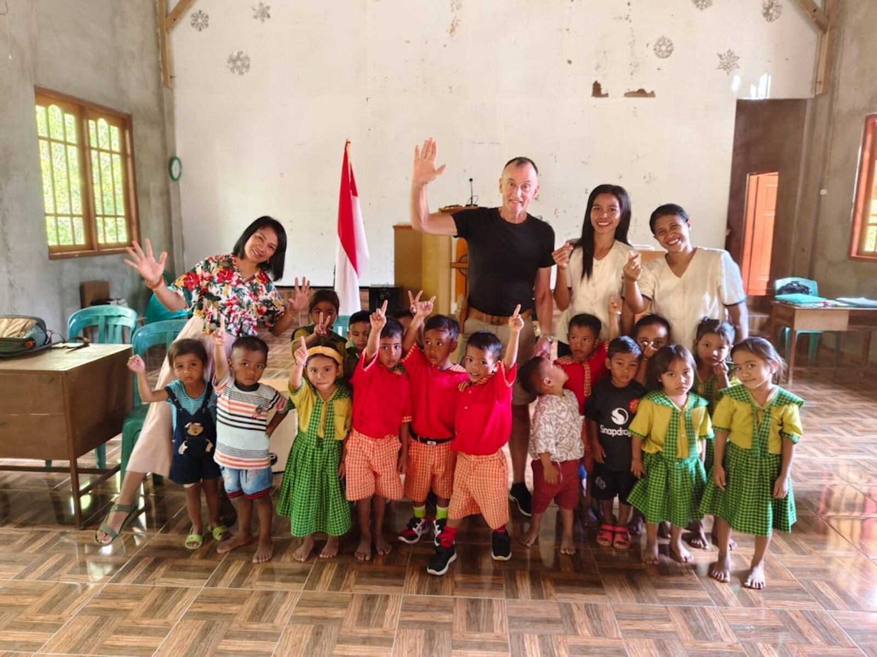
Children supported by Setia

Slide 5
Give to Christian education
IBAN: NL61 RABO 0321 4429 89
In the name of Stichting Setia, 't Harde
Stichting Setia is a registered Dutch charity (ANBI).
stichtingsetia.nl

