Slide 1

STICHTING SETIA
For Christian education in Indonesia
Setia means faithful. We believe every child has a right to Christian education, in Indonesia too.

Slide 2
Teacher training in Atambua, Timor
Timor
stichtingsetia.nl

Slide 3
About this project
In the border region near Atambua on Timor, Setia supports a training college for Christian kindergarten and primary-school teachers.
stichtingsetia.nl

Slide 4
What we concretely need
Foundation of a classroom: € 3000
Walls and structure of a classroom: € 2500
Roof of a classroom: € 1500
Floor tiles: € 1000
stichtingsetia.nl

Slide 5
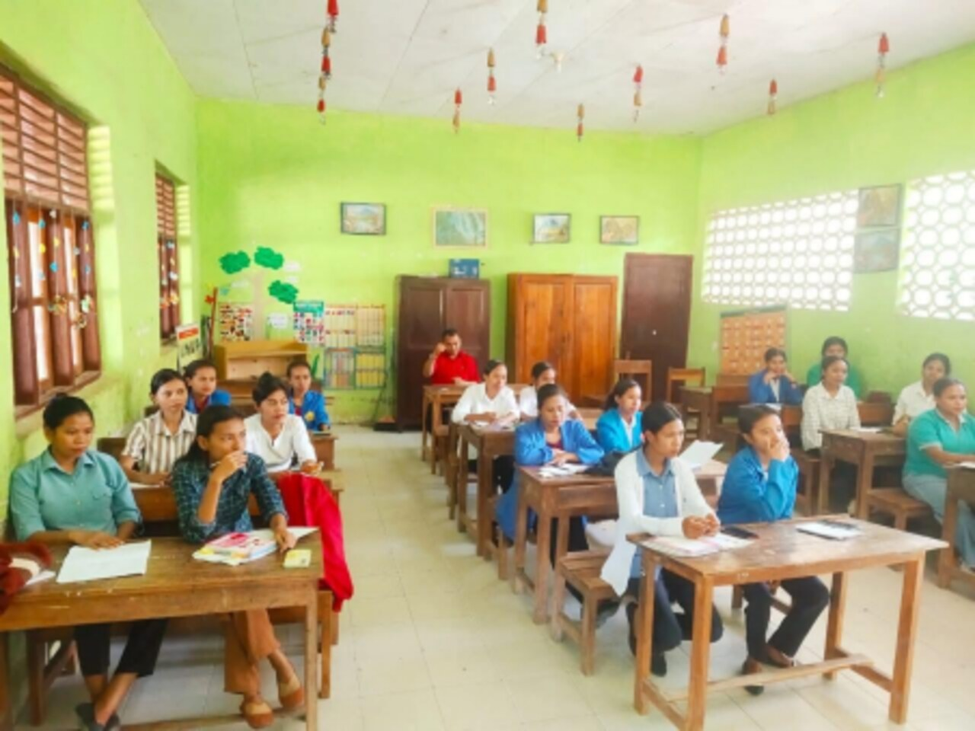
Teacher training in Atambua, Timor

Slide 6
Give to Christian education
IBAN: NL61 RABO 0321 4429 89
In the name of Stichting Setia, 't Harde
reference: project code T-25-01
Stichting Setia is a registered Dutch charity (ANBI).
stichtingsetia.nl

