Slide 1

STICHTING SETIA
For Christian education in Indonesia
Setia means faithful. We believe every child has a right to Christian education, in Indonesia too.

Slide 2
Gezinshuis Kupang op Timor
Timor
stichtingsetia.nl

Slide 3
About this project
Just outside Kupang on Timor, the Setia family house gives children a safe place to live and to go to school.
stichtingsetia.nl

Slide 4
What we concretely need
Chicken: € 100
Goat: € 500
Further study for young people: € 1200
New refrigerator: € 350
Paving the outdoor area: € 200
New fence around the site: € 75
stichtingsetia.nl

Slide 5
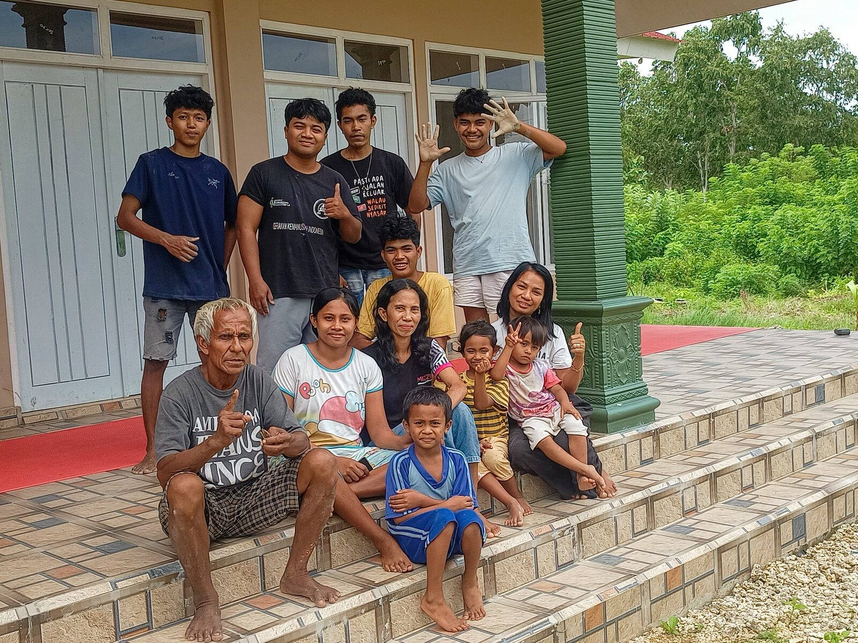
Gezinshuis Kupang op Timor

Slide 6
Give to Christian education
IBAN: NL61 RABO 0321 4429 89
In the name of Stichting Setia, 't Harde
reference: project code T-23-07
Stichting Setia is a registered Dutch charity (ANBI).
stichtingsetia.nl

