Slide 1

STICHTING SETIA
For Christian education in Indonesia
Setia means faithful. We believe every child has a right to Christian education, in Indonesia too.

Slide 2
Kindergarten education on Sumba
Overig
stichtingsetia.nl

Slide 3
About this project
On Sumba, Setia supports two kindergartens that have just started, so that the youngest children there receive an education.
stichtingsetia.nl

Slide 4
What we concretely need
Training for the teachers: € 300
School uniforms: € 550
Learning materials: € 350
School supplies: € 600
stichtingsetia.nl

Slide 5
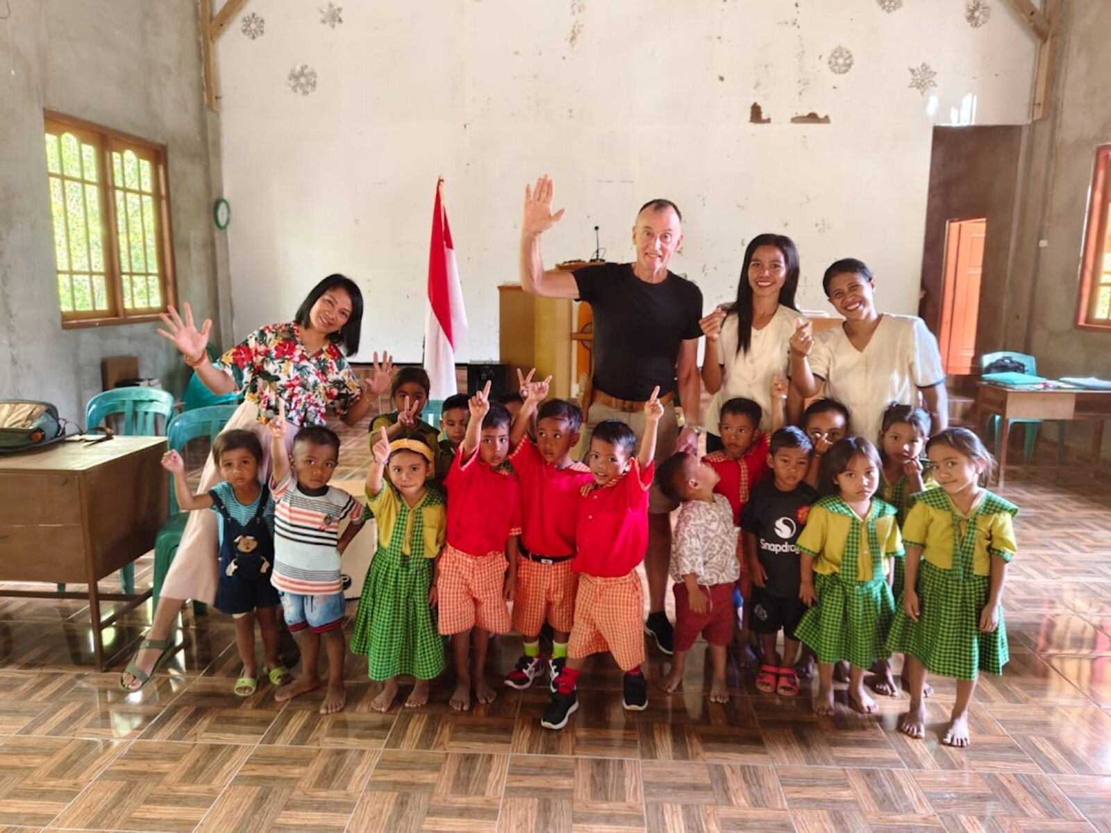
Kindergarten education on Sumba

Slide 6
Give to Christian education
IBAN: NL61 RABO 0321 4429 89
In the name of Stichting Setia, 't Harde
reference: project code S-26-01
Stichting Setia is a registered Dutch charity (ANBI).
stichtingsetia.nl

