Slide 1

STICHTING SETIA
For Christian education in Indonesia
Setia means faithful. We believe every child has a right to Christian education, in Indonesia too.

Slide 2
Kleuterschool van Alet in Dungkan op Kalimantan Barat
Kalimantan
stichtingsetia.nl

Slide 3
About this project
Alet runs a kindergarten in the village of Dungkan in West Kalimantan and gives the children a nourishing meal every week.
stichtingsetia.nl

Slide 4
What we concretely need
Learning materials 2026: € 200
Weekly meal 2026: € 300
Support for Alet 2026: € 600
stichtingsetia.nl

Slide 5
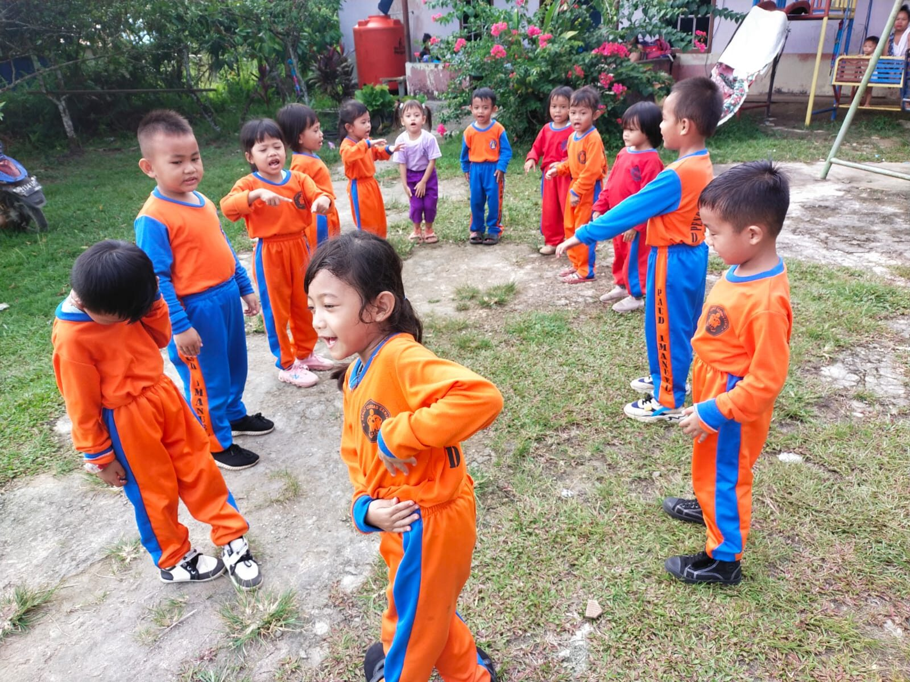
Kleuterschool van Alet in Dungkan op Kalimantan Barat

Slide 6
Give to Christian education
IBAN: NL61 RABO 0321 4429 89
In the name of Stichting Setia, 't Harde
reference: project code K-23-01
Stichting Setia is a registered Dutch charity (ANBI).
stichtingsetia.nl

