Slide 1

STICHTING SETIA
For Christian education in Indonesia
Setia means faithful. We believe every child has a right to Christian education, in Indonesia too.

Slide 2
Hulp aan scholen in Malang
Java
stichtingsetia.nl

Slide 3
About this project
Together with Petrus Widyaya, Setia supports Christian schools in Malang that provide good education.
stichtingsetia.nl

Slide 4
What we concretely need
Renovation of 2 classrooms at SMP Kristen 1: € 3500
stichtingsetia.nl

Slide 5
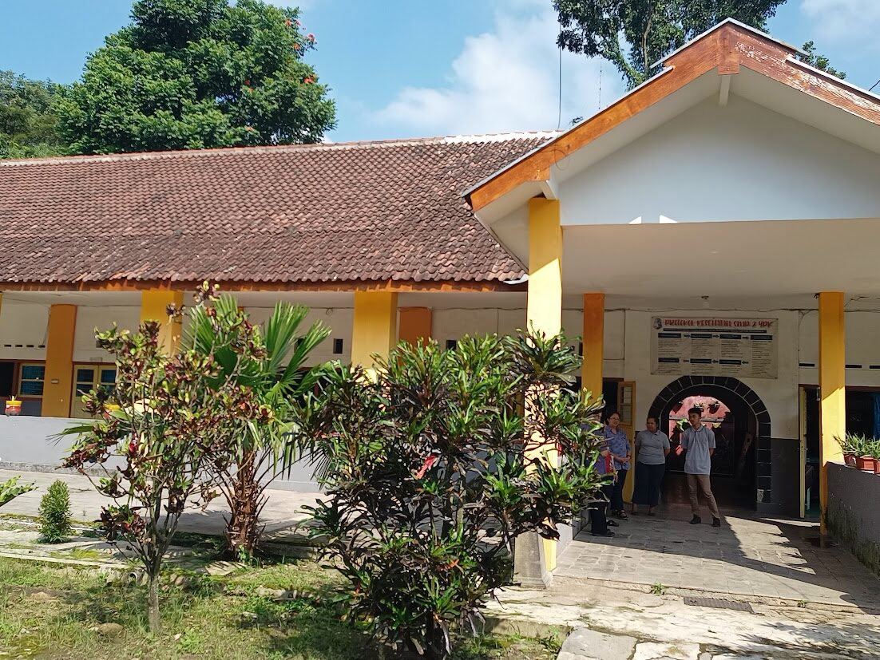
Hulp aan scholen in Malang

Slide 6
Give to Christian education
IBAN: NL61 RABO 0321 4429 89
In the name of Stichting Setia, 't Harde
reference: project code J-25-02
Stichting Setia is a registered Dutch charity (ANBI).
stichtingsetia.nl

