Slide 1

STICHTING SETIA
For Christian education in Indonesia
Setia means faithful. We believe every child has a right to Christian education, in Indonesia too.

Slide 2
Griya Kinasih boarding home in Malang
Java
stichtingsetia.nl

Slide 3
About this project
In Malang, the Griya Kinasih boarding home gives forty to fifty children from across Indonesia a place to live and go to school.
stichtingsetia.nl

Slide 4
What we concretely need
Your gift goes straight to this Christian education project.
stichtingsetia.nl

Slide 5
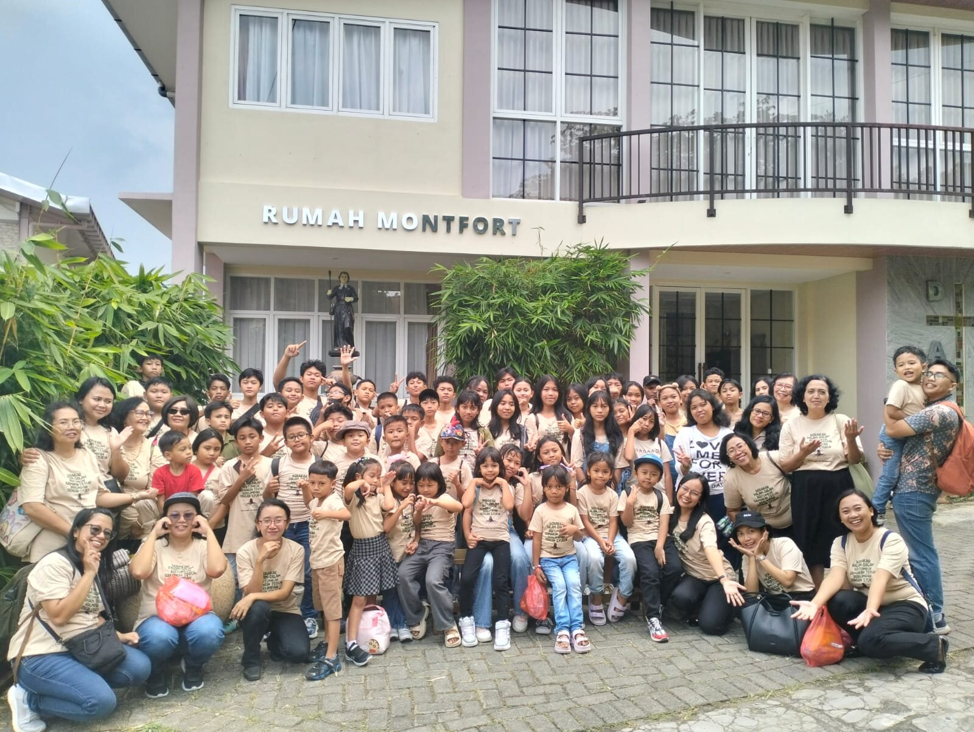
Griya Kinasih boarding home in Malang

Slide 6
Give to Christian education
IBAN: NL61 RABO 0321 4429 89
In the name of Stichting Setia, 't Harde
reference: project code J-23-02
Stichting Setia is a registered Dutch charity (ANBI).
stichtingsetia.nl

